Slide 1
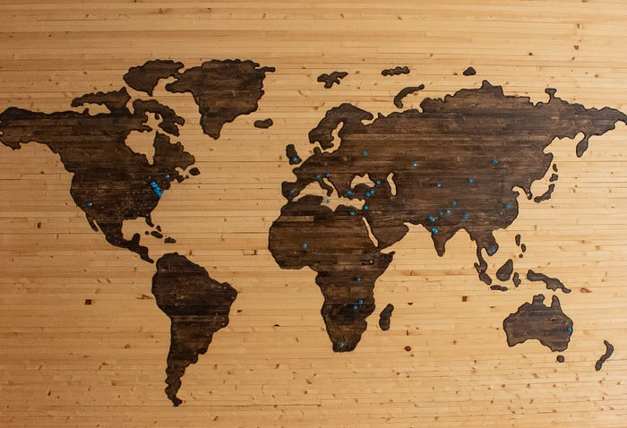
Working with Geospatial Data

Slide 2
Geospatial data
Spatial data is the information about the location and shape of geographical features and the relationship between them
This data includes information about the Earth's surface, such as topography, land use, climate, and human-made features like roads and buildings.
It is collected through various means, including GPS, remote sensing, and surveys.

Slide 3
Types of Geospatial data
Vector Data:
Points: Represent discrete locations on the Earth's surface, often defined by latitude and longitude coordinates. Examples include cities, landmarks, and sampling locations.
Lines (Polylines): Represent linear features or paths, such as roads, rivers, and boundaries.
Polygons: Represent areas or regions with well-defined boundaries, like countries, states, and parcels of land. Polygons are defined by a series of connected lines.
Raster Data:
Grids or Pixels: Represent data as a regular grid of cells, where each cell contains a value representing a property or attribute for a specific location on the Earth's surface. Examples include satellite imagery, elevation models, and land cover data.

Slide 4
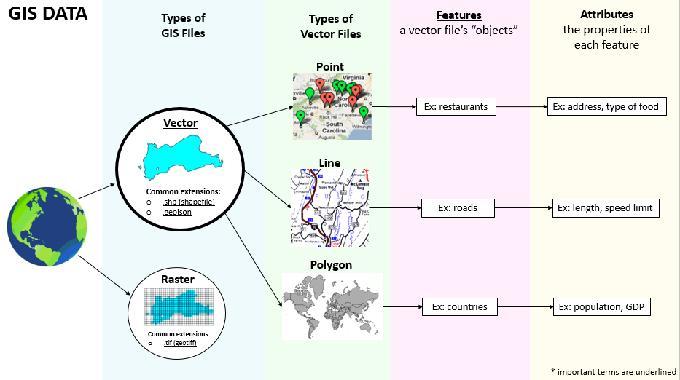
Types of Geospatial data

Slide 5
Geographic information system (GIS)
A geographic information system (GIS) is a system that creates, manages, analyzes, and maps all types of data.
GIS connects data to a map, integrating location data (where things are) with all types of descriptive information (what things are like there).
This provides a foundation for mapping and analysis that is used in science and almost every industry.
GIS helps users understand patterns, relationships, and geographic context.
The benefits include improved communication and efficiency as well as better management and decision making.

Slide 6
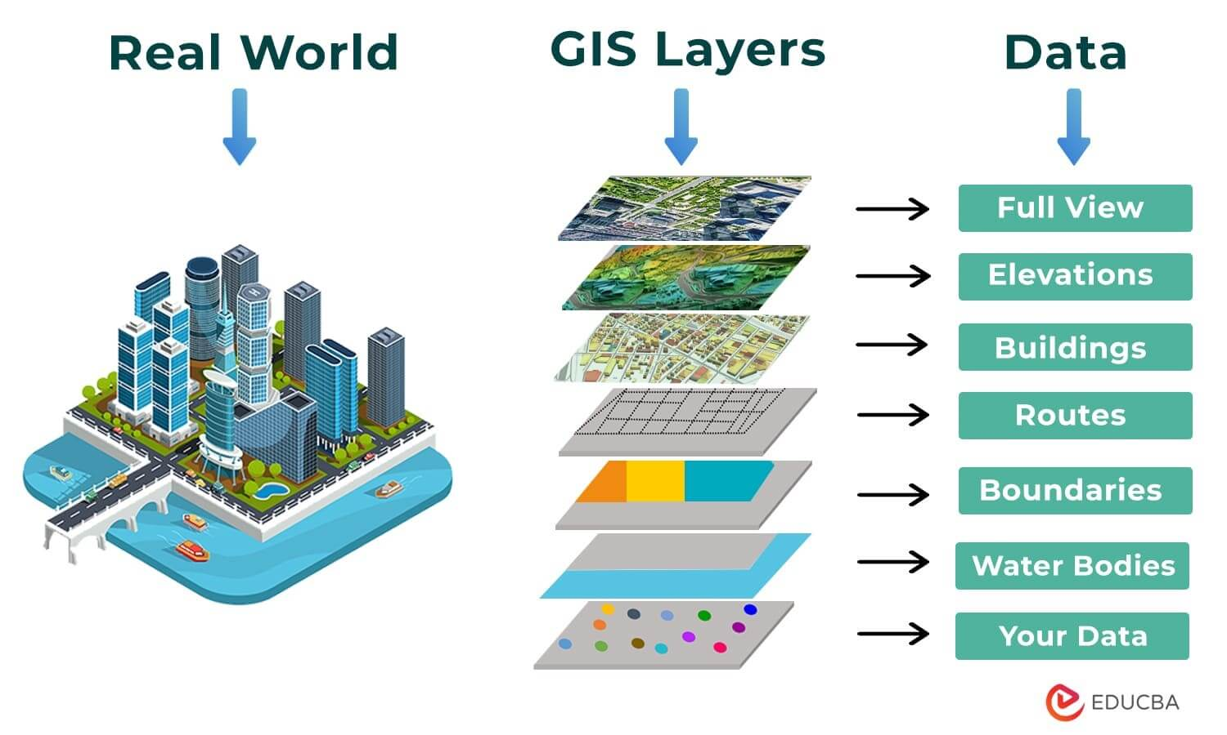
Geographic information system (GIS)

Slide 7
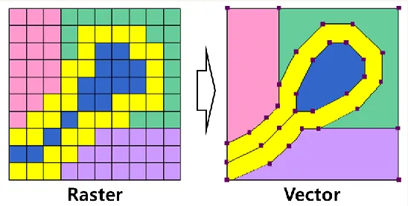
Storing the Geospatial data
Vector data is represented through points, lines, and polygons stored in shapefiles (.shp) whereas raster data is image-like data stored in a grid of pixels (eg. Satellite imagery).
Another format to store spatial data is GeoJson. If you want to get yourself familiar with this, you can visit geojson.io which is a very intuitive tool for editing GeoJson data using a map interface.

Slide 8
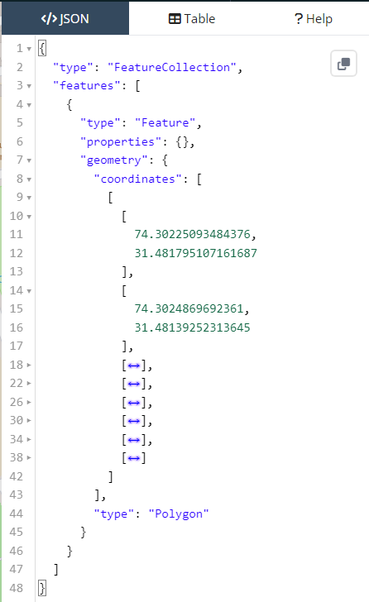
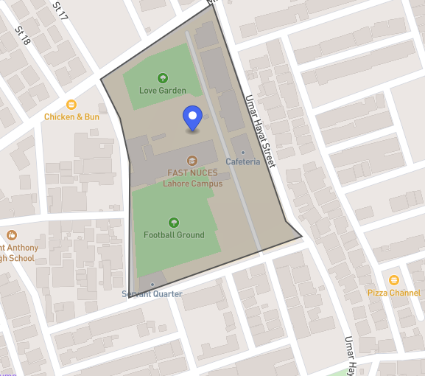
Storing the Geospatial data
Following is an example of spatial data
represented as a polygon

Slide 9
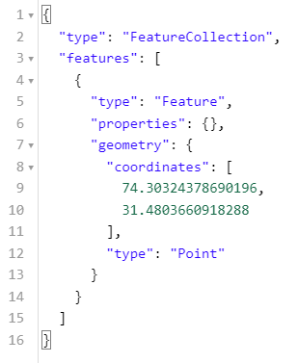
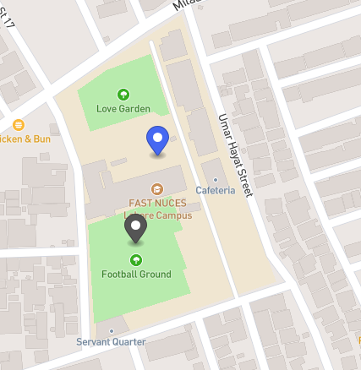
Storing the Geospatial data
Following is an example of spatial data
represented as a point

Slide 10
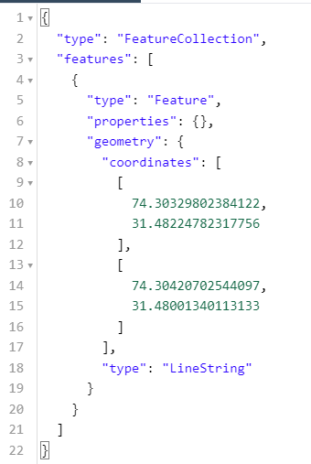
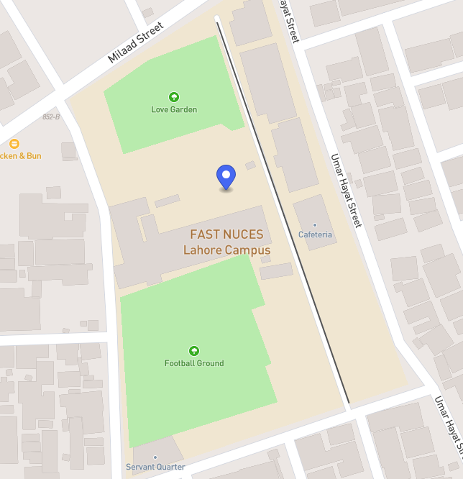
Storing the Geospatial data
Following is an example of spatial data
represented as a line

Slide 11
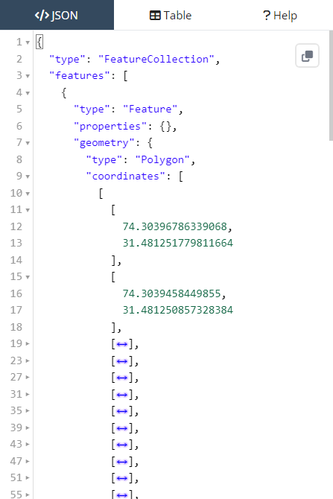
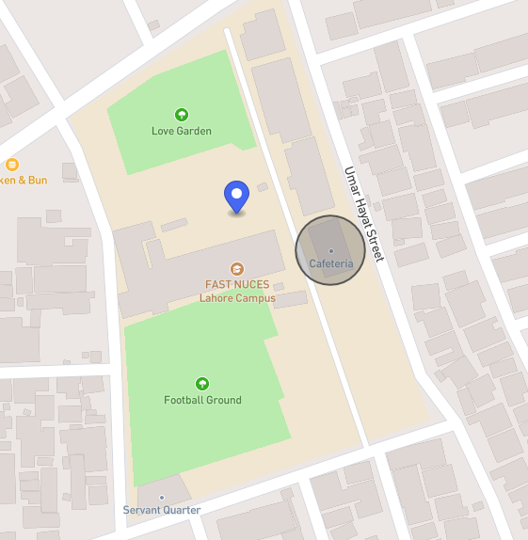
Storing the Geospatial data
Following is an example of spatial data
represented as a circular polygon

Slide 12
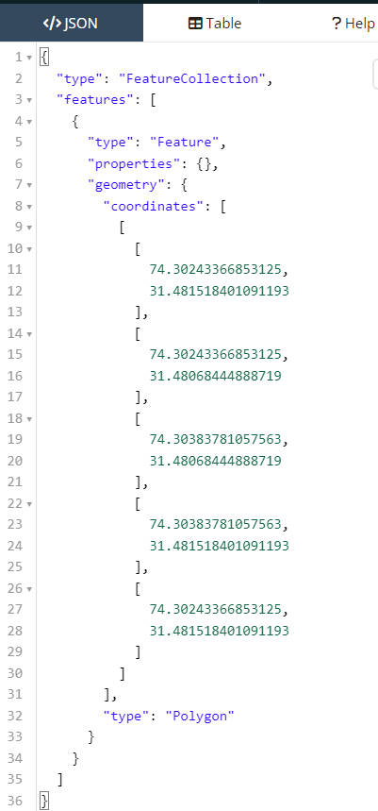
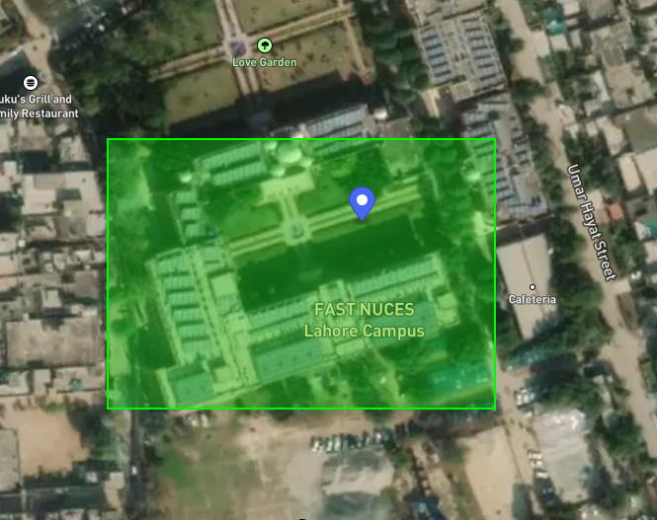
Storing the Geospatial data
Following is an example of spatial data
represented as a rectangle

Slide 13
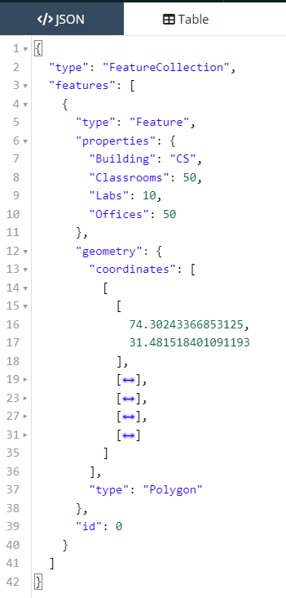
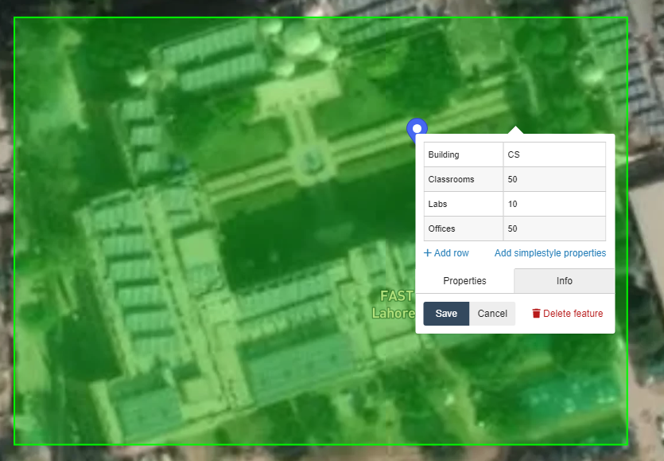
Storing the Geospatial data
Adding attributes

Slide 14
Geospatial Technologies
Remote Sensing
Space or airborne camera and sensor platforms provide imagery and data at great detail. Images that can zoom into less than one meter are available on some commercial satellites.
Geographic Information System (GIS)
Offers software that can map a specific geographic location anywhere on Earth and analyze geospatial data. GIS geospatial can also detect patterns in the data.
Global Positioning System (GPS)
Provides coordinate locations for military and civilian use through a network of U.S. Department of Defense satellites. A European version is called Galileo.
Internet Mapping Technologies
Google Earth and Microsoft Virtual Earth are examples of geospatial software and geospatial mapping tools that makes it easier for people to view and share geospatial data.

Slide 15
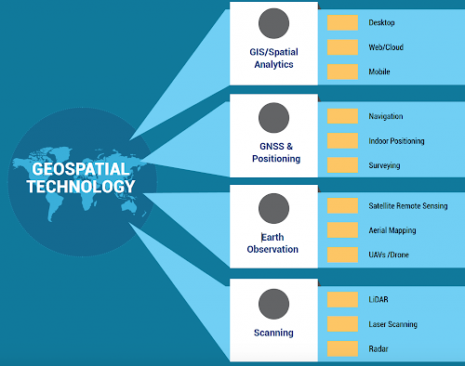
Geospatial Technologies

Slide 16
Applications
Urban Planning and Development:
GIS helps city planners manage land use, zoning, transportation networks, and infrastructure development. It assists in optimizing city layouts and improving urban living conditions.
Environmental Management and Conservation:
GIS is crucial for monitoring and managing natural resources, tracking environmental changes, and planning conservation efforts. It's used in land cover analysis, wildlife habitat mapping, and disaster management.
Public Health and Healthcare:
GIS is employed to track disease outbreaks, plan healthcare facility locations, and analyze the relationship between health outcomes and environmental factors like pollution and access to healthcare.
Emergency Response and Disaster Management:
GIS aids in disaster preparedness, response, and recovery by providing real-time mapping of affected areas, identifying vulnerable populations, and managing resources during crises like wildfires, hurricanes, and earthquakes.

Slide 17
Applications
Transportation and Logistics:
GIS optimizes transportation routes, aids in traffic management, and supports logistics operations. It's used for route planning, vehicle tracking, and public transit optimization.
Agriculture and Precision Farming:
GIS assists in farm management by providing insights into soil quality, crop yield, and irrigation needs. Precision farming uses GIS to enhance productivity and reduce environmental impact.
Natural Resource Management:
Forestry, mining, and oil and gas industries use GIS to plan resource extraction, manage land, and monitor environmental impact.
Real Estate and Property Management:
GIS is used for property assessment, land parcel identification, and location-based decision-making in the real estate industry.

